Slide 1
SOFTWARE PROJECT MODELS

Slide 2
SDLC
A software development process, also known as a software development life-cycle (SDLC), is a structure imposed on the development of a software product. Similar terms include software life cycle and software process.

Slide 3
Software Development Activities
1. PLANNING
Planning is an objective of each and every activity, where we want to discover things that belong to the project. An important task in creating a software program is extracting the requirements or requirements analysis.

Slide 4
Software Development Activities
2. IMPLEMENTATION, TESTING AND DOCUMENTING
Implementation is the part of the process where software engineers actually program the code for the project.

Slide 5
Software Development Activities
2. IMPLEMENTATION, TESTING AND DOCUMENTING
Software testing is an integral and important phase of the software development process. This part of the process ensures that defects are recognized as soon as possible.

Slide 6
Software Development Activities
2. IMPLEMENTATION, TESTING AND DOCUMENTING
Documenting the internal design of software for the purpose of future maintenance and enhancement is done throughout development.

Slide 7
Software Development Activities
3. DEPLOYMENT AND MAINTENANCE
Deployment starts directly after the code is appropriately tested, approved for release, and sold or otherwise distributed into a production environment. This may involve installation, customization (such as by setting parameters to the customer's values), testing, and possibly an extended period of evaluation.

Slide 8
Software Development Activities
3. DEPLOYMENT AND MAINTENANCE
Maintaining and enhancing software to cope with newly discovered faults or requirements can take substantial time and effort, as missed requirements may force redesign of the software.

Slide 9
Software Development Models
WATERFALL MODEL
The waterfall model shows a process, where developers are to follow these phases in order:
Requirements specification (Requirements analysis)
Software design
Implementation and Integration
Testing (or Validation)
Deployment (or Installation)
Maintenance

Slide 10
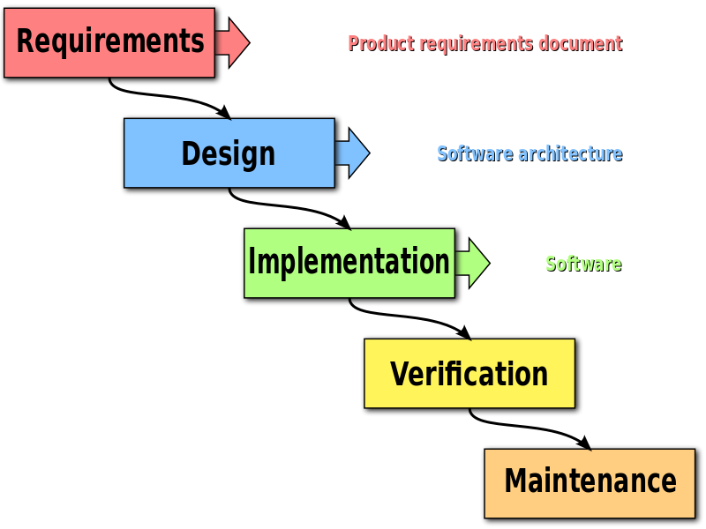
Software Development Models

Slide 11
Software Development Models
SPIRAL MODEL
The key characteristic of a Spiral model is risk management at regular stages in the development cycle. In 1988, Barry Boehm published a formal software system development "spiral model," which combines some key aspect of the waterfall model and rapid prototyping methodologies, but provided emphasis in a key area many felt had been neglected by other methodologies: deliberate iterative risk analysis, particularly suited to large-scale complex systems.

Slide 12
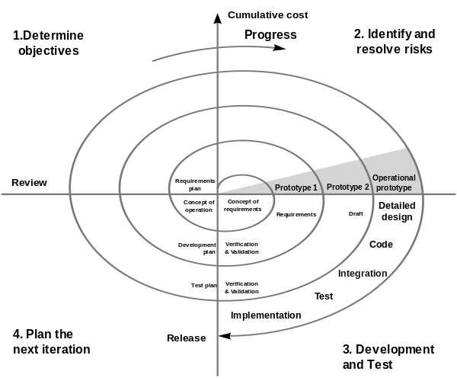
Software Development Models

Slide 13
Software Development Models
EXTREME PROGRAMMING (XP)
A software development methodology which is intended to improve software quality and responsiveness to changing customer requirements. As a type of agile software development, it advocates frequent "releases" in short development cycles, which is intended to improve productivity and introduce checkpoints where new customer requirements can be adopted.

Slide 14
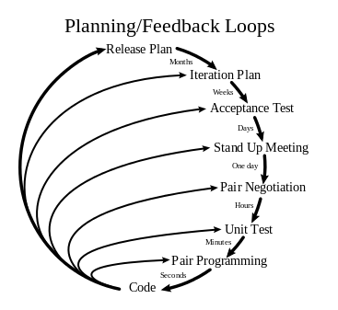
Software Development Models

Slide 15
Software Development Models
AGILE DEVELOPMENT
Agile software development uses iterative development as a basis but advocates a lighter and more people-centric viewpoint than traditional approaches. Agile processes fundamentally incorporate iteration and the continuous feedback that it provides to successively refine and deliver a software system.

Slide 16
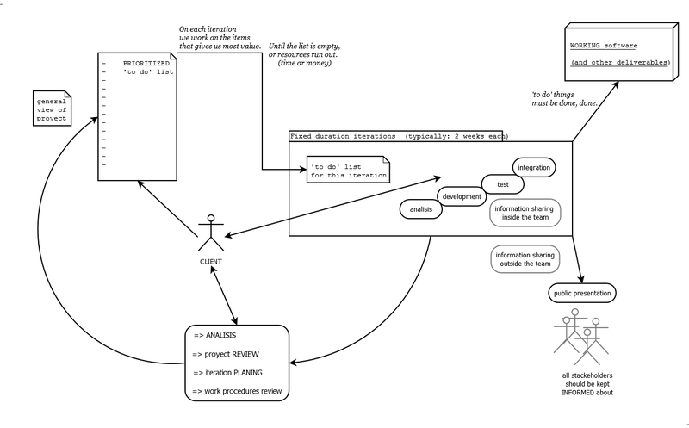
Software Development Models

Slide 17
Software Development Models
RAPID APPLICATION DEVELOPMENT (RAD)
R.A.D is a software development methodology that uses minimal planning in favor of rapid prototyping. The "planning" of software developed using RAD is interleaved with writing the software itself. The lack of extensive pre-planning generally allows software to be written much faster, and makes it easier to change requirements. RAD involves methods like iterative development and software prototyping.

Slide 18
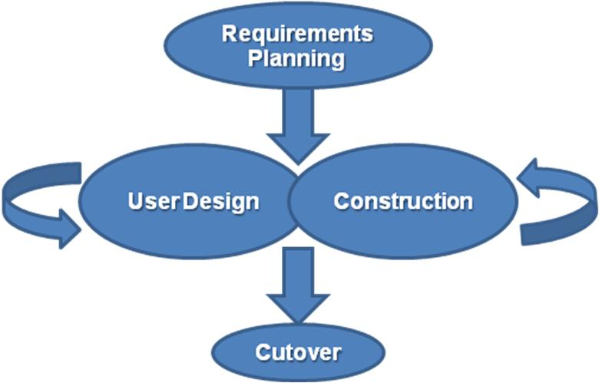
Software Development Models

Slide 19
QUESTIONS???

Slide 20
